Slide 1
SMART MEDIBOX
GUIDED BY
SURJITH S
ASSISTANT PROFESSOR
DEPT OF ELECTRONICS AND
COMMUNICATIONS ENGINEERING
SMRITHI V
ASSISTANT PROFESSOR
DEPT OF ELECTRONICS AND
COMMUNICATIONS ENGINEERING
ABISA M – 2
AKHILA JOY – 5
KALYANI M J – 29
POOJA JEEVAN - 33

Slide 2
OBJECTIVE
Many of old people live alone and suffer from disability, making it harder to take care of themselves.
The health and wealth are critical to human society
INTERNET OF MEDICAL THINGS (IOMT) is connected to IOT network.
Multipurpose intelligent device named MEDIBOX-IOT Enabled patient assisting device.
Device maintains the parameters like temperature and humidity in a controlled range.
Thus maintains the quality of the medicine.

Slide 3
Contd….
Host Management system (HMS) - capable of IOT monitoring.
MEDIBOX takes control on alerting patients to take medicine.
Avoids wrong medications at wrong time.
It also confirms the medicine taken by the patient.
Along with these features we are added health monitoring sensors.
An emergency button to enable communication

Slide 4
Contd…
For more security and privacy we provide locking system.
The patient or caretaker can refill the medicine box.
A mobile application is made with patients and caretaker login
Which contains all details regarding the patient.

Slide 5
LITERATURE REVIEW
Sl.no | NAME | METHADOLOGY | CONCLUSION | DISADVANTAGES
1 | A Modern health monitoring care system using iot and android(2016) | Hospital server, andriod application, arduino uno and temperature sensor | Health IOT thus helps the hospital authorities to have continous monitoring on the patients as well as it reminds the patient to have the medicines on time. So the doctor can have direct view over his patients by this.Thus the medication procedures can be shifted from hospital centric to home | It doesnot provide security It has no messaging system.
2 | A health-IoT platform based on the bios- ensor and intel- ligent medicine box(2017) | Arduino uno, Raspberry pi, Doctors android app | It is an IoT-based intelligent home-centric healthcare platform (iHome system), which seamlessly connects smart sensors attached to human body for physiological monitoring and intelligent pharmaceutical packaging for daily medication management | Always need wifi connection

Slide 6
Contd….
3 | Smart Medicine Box for Patient Using NFC(2017) | ANDROID DEVICE and NFC-TAGS | Implemented smart medicine box using NFC tag which helps to old practice as well and also applying data mining technique for predicting disease using patient’s symptoms. Providing health reminder in day to day busy life | It has no sensor It is not portable. Because of less battery backup
4 | Smart Medicine Dispenser (SMD)(2018 | Android application Database management using MySQL, SMD modular and Arduino uno | The major point is SMD. Elderly patients, especially ones with chronic and periodic medicine, will benefit the most for the SMD, since it will greatly increase their medicine adherence which will insure a better treatment effectiveness or even save their lives | No cooling system Less pill container

Slide 7
Contd…
5 | IoT Enabled Assisting Device for Seizures Monitoring(2019) | Internet of Medical Things (IoMT) is associated with IoT, Host Management System (HMS), Arduino uno and Cloud storage | It helping a patient totally with a conse- rvative and easy to understand way. It reminds the patient to devour the meds and gives a reasonable stockpiling condition to the medications. Capacity of prescriptions consumption subtleties can help the specialist for future references | It doesnot provide privacy It has no health sensors
6 | A smart medicine box for medication management using iot(2020) | Arduino mega, GSM module, temperature sensor, peltier module, heart rate sensor and servo motor | IoT based smart medicine box designed with embedded system to overcome the holes of elder patient’s ambient living. The Wi-Fi connected box transfer the daily activities of the respective patient’s health details and their medication details added with benefit of GSM mode alert SMS. This box design comforts the people to take the drugs at right dose at right time. | It doesnot provide privacy and security

Slide 8
Contd…
7 | Ibox: smart medicine box with iot application(2020) | NodeMCU, IoT, Database, Blynk, think speak, microcontroller | It presented the method of integrating the IoT into the medicine box. This could become a guideline for anyone especially who is new in applying the IoT . By applying the IoT concept, a real time reminder and notification can be created in assisting user for his medicine taking routine. | It has no cooling system and health monitoring sensors
8 | Medibox -iot enabled patient assisting device(2021) | Arduino Software (IDE), temperature Sensor (Thermistor),VoltageDivider,ArduinoUno, Bluetooth Module HC- 04, SCU, ECG Electrode | It aims at assisting a patient completely with a compact and user- friendly manner. It reminds the patient to consume the medications and provides a suitable storage condition for the drugs. Storage of medications intake details can assist the doctor for future references | it has no more sensors It dosnot provide privacy and security

Slide 9
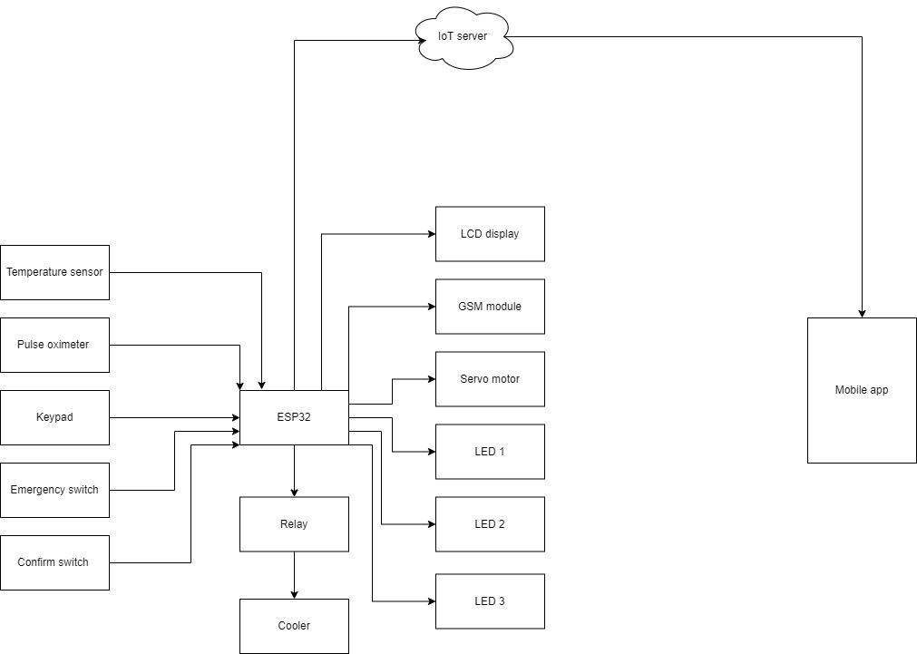
BLOCK DIAGRAM

Slide 10
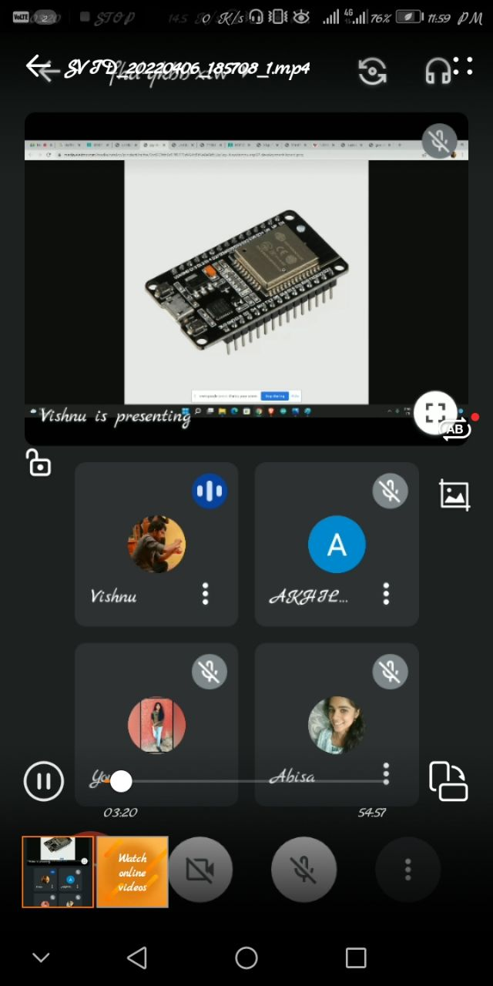
METHODOLOGY
MICROCONTROLLER
ESP32 does the function of a computer where the hardware projects can be build using the software
programmed on the micro controller.
It can be connected to other components like sensors, actuators and transmitters to receive and send the signals.

Slide 11
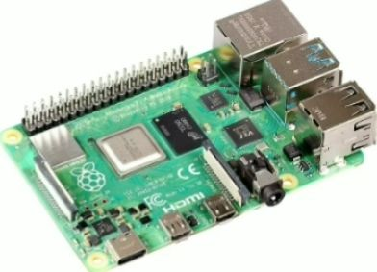
RTC
Real Time Clock module is a battery operated module that derives only less power from the power supply.
Its interfacing with ESP32 is provided with range about 5v.
The time and date is set at this module and doesn’t gets reset on power shut down. The time and date runs automatically from which it is set initially.
It is more accurate and updated. This module is connected with ESP32 through its serial connection pins.
When the user pre-set time matches the programmed reminder time, it triggers the Alarm to alert patients to take medicine at right time.

Slide 12
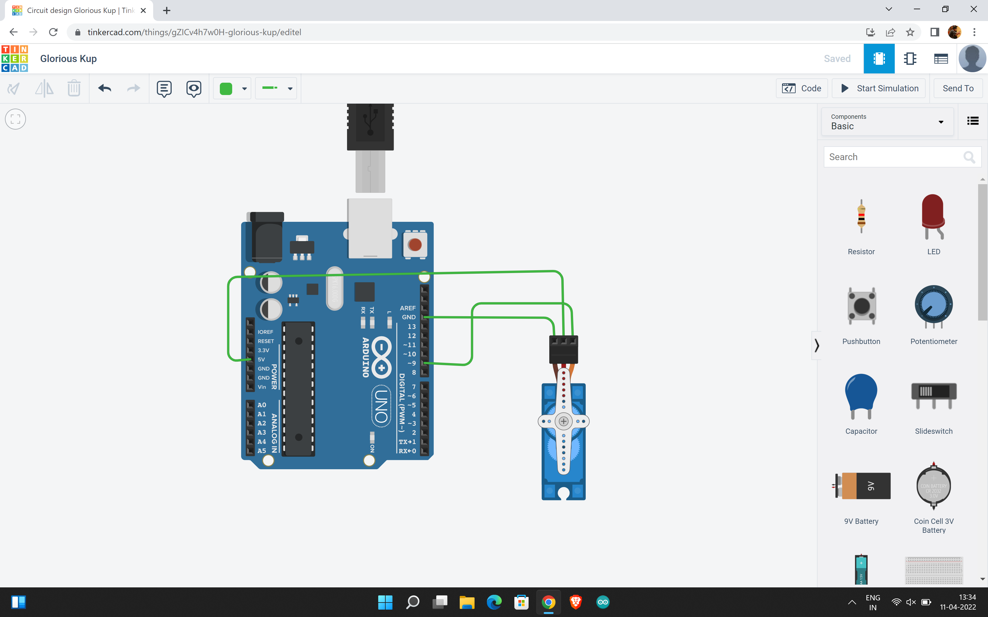
SERVO MOTOR A servomotor (or servo motor) is a rotary actuator or linear actuator that allows for precise control of angular or linear position, velocity and acceleration. It consists of a suitable motor coupled to a sensor for position feedback.
 | Servo myservo; int pos =0; void setup() { myservo.attach(9); } void loop() { for (pos =0; pos<=180; pos+= 1) { myservo.write(pos); } for (pos =180; pos>=0; pos-= 1) { myservo.write(pos); delay(15); }

Slide 13
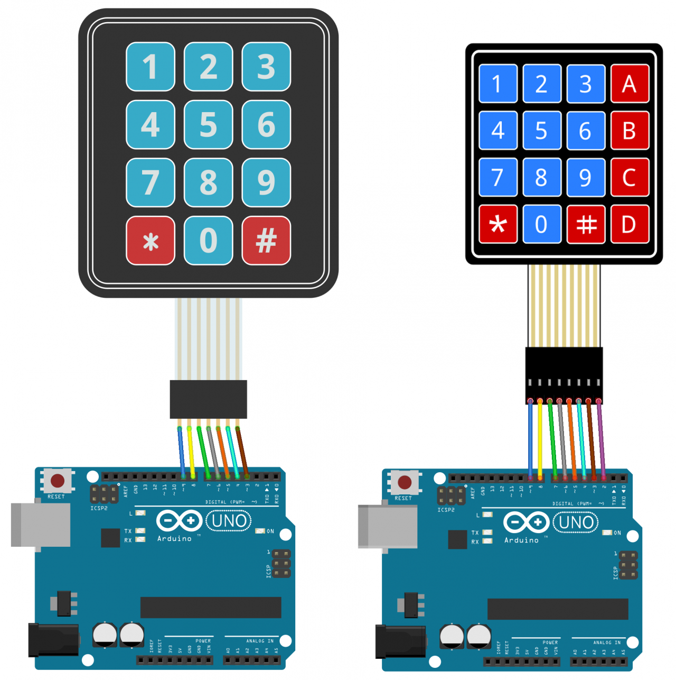
KEYPAD
To secure the medicine box which was a drawback in previous papers, here we had included the password setting using keypad.
Only authorized user can access the medicine box through entering the correct pin number to prevent misuse of drugs by unauthorized people as well as child security.

Slide 14
#include <Keypad.h> const byte ROWS = 4; const byte COLS = 4; char hexaKeys[ROWS][COLS] = { {'1', '2', '3', 'A'}, {'4', '5', '6', 'B'}, {'7', '8', '9', 'C'}, {'*', '0', '#', 'D'} }; byte rowPins[ROWS] = {9, 8, 7, 6}; byte colPins[COLS] = {5, 4, 3, 2}; Keypad customKeypad = Keypad(makeKeymap(hexaKeys), rowPins, colPins, ROWS, COLS); void setup(){ Serial.begin(9600);} void loop(){ char customKey = customKeypad.getKey(); if (customKey){ Serial.println(customKey); } }

Slide 15
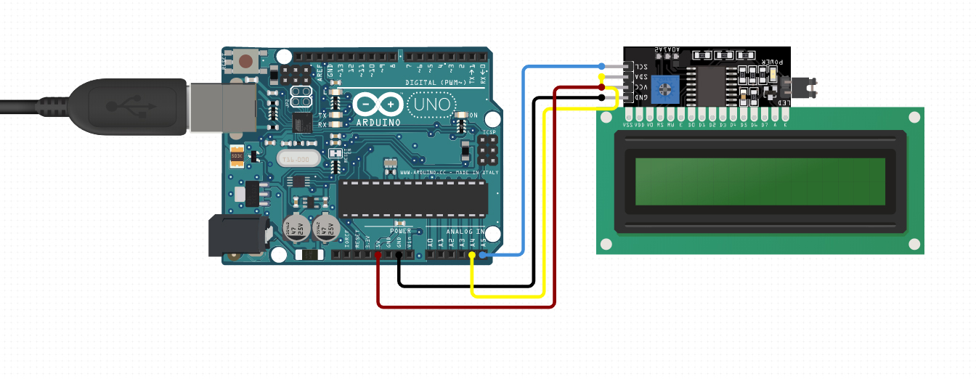
LCD
The LCD is a liquid crystal display. There are various sizes in the LCD. The display can be done based on the applications like 8X1, 8X2 and so on. The function of the LCD is to get the data from the micro controller and displays the information as programmed in the micro controller.
 | #include <LiquidCrystal.h> LiquidCrystal lcd(12, 11, 5, 4, 3, 2); void setup() { lcd.begin(16, 2); //lcd.print("hello, world!"); } void loop() { lcd.setCursor(1,1); lcd.print("hello, world!"); }

Slide 16

BUZZER
A buzzer is used to give the alert symbol.
It is embedded with all the system in the micro controller.
Buzzer alerts the user with a beep sound.
They are the integrated electronic transducers.

Slide 17
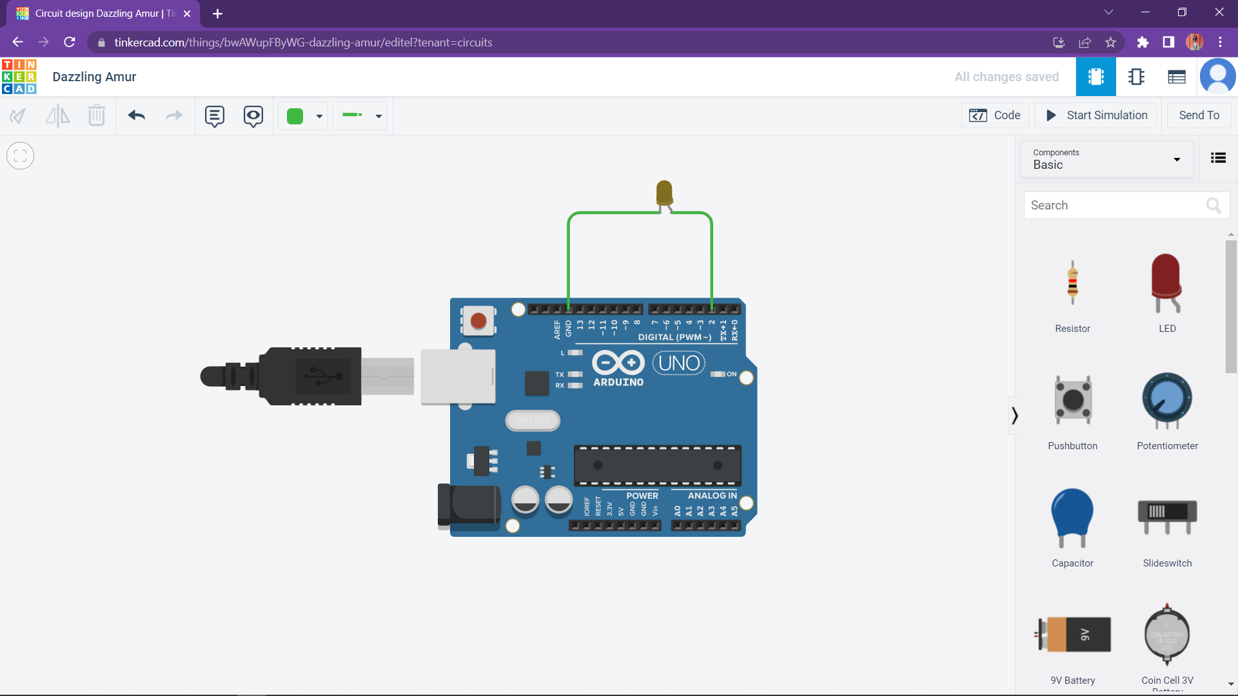
LED
LED light shows which medicine to be taken at that time. Avoids taking of wrong medicines.
 | void setup() { pinMode(9,OUTPUT); } void loop() { digitalWrite(9,1); }

Slide 18
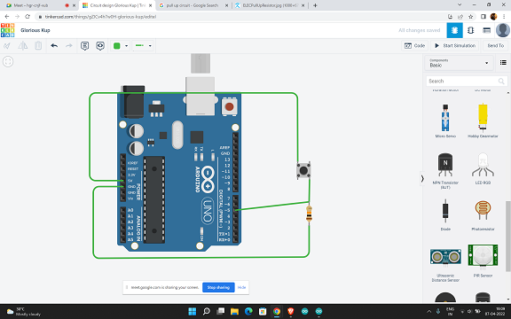
CONFIRM SWITCH To confirm that the medicine have taken. On pressing the switch the will buzzer stops other wise buzzer starts again. On clicking the switch medicine TAKEN will be stored in the app.

Slide 19
// digital pin 2 has a pushbutton attached to it. Give it a name: int pushButton = 2; // the setup routine runs once when you press reset: void setup() { // initialize serial communication at 9600 bits per second: Serial.begin(9600); // make the pushbutton's pin an input: pinMode(pushButton, INPUT); } // the loop routine runs over and over again forever: void loop() { // read the input pin: int buttonState = digitalRead(pushButton); // print out the state of the button: Serial.println(buttonState); delay(1); // delay in between reads for stability }

Slide 20
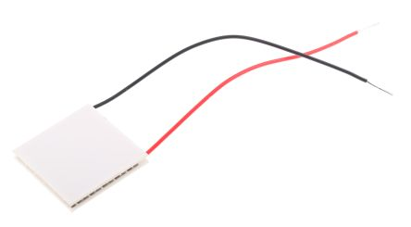
PELTIER MODULE
The peltier effect is the principle of this module which outputs the cold effect as a result of temperature differences between two sides when voltage transports from side to other side of module. It is a thermoelectric generator module operating at 12v supply along with exhaust fan and heat sink to get rid of heat generated as a result of cooling process.

Slide 21
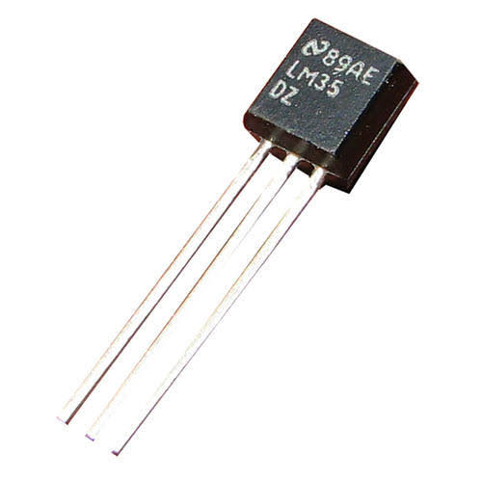
SENSORS
Temperature sensor
Used to measure the human body temperature.
.

Slide 22
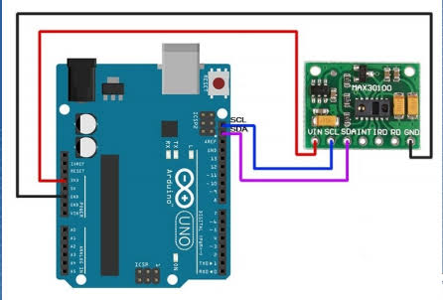
Pulse oximeter
It’s a pulse oximeter and heart rate sensor.
A modern, integrated pulse oximeter and heart rate sensor IC, from analog devices.
It combines two led's, a photo detector, optimized optics, and low-noise analog signal processing to
Detect pulse oximetry (spo2) and heart rate (HR) signals.
#include <Wire.h> #include "MAX30100_PulseOximeter.h“ #define REPORTING_PERIOD_MS 1000 // PulseOximeter is the higher level interface to the sensor // it offers: // * beat detection reporting // * heart rate calculation // * SpO2 (oxidation level) calculation PulseOximeter pox; uint32_t tsLastReport = 0; // Callback (registered below) fired when a pulse is detected void onBeatDetected()

Slide 23
{ Serial.println("Beat!"); } void setup(){ Serial.begin(115200); Serial.print("Initializing pulse oximeter.."); // Initialize the PulseOximeter instance // Failures are generally due to an improper I2C wiring, missing power supply // or wrong target chip if (!pox.begin()) { Serial.println("FAILED"); for(;;); } else { Serial.println("SUCCESS"); } // Register a callback for the beat detection pox.setOnBeatDetectedCallback(onBeatDetected); } void loop(){ // Make sure to call update as fast as possible pox.update(); // Asynchronously dump heart rate and oxidation levels to the serial

Slide 24
// For both, a value of 0 means "invalid" if (millis() - tsLastReport > REPORTING_PERIOD_MS) { Serial.print("Heart rate:"); Serial.print(pox.getHeartRate()); Serial.print("bpm / SpO2:"); Serial.print(pox.getSpO2()); Serial.println("%"); tsLastReport = millis(); } }

Slide 25
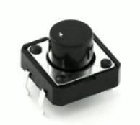
Emergency Switch An emergency switch is to enable communications.

Slide 26
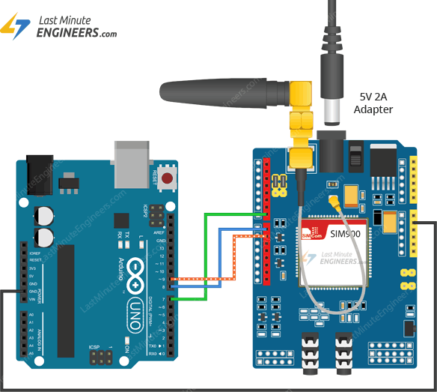
GSM MODULE
The feature of updating patient tablet taken details through SMS (Short Message Service) is done through GSM or GPRS module.
The allotted SIM card number receives the statements as “TABLET TAKEN” or “TABLET NOT TAKEN” on the occurrence of combination of logic gates which results on switches pressed per day.
Even the patient’s emergency condition is acknowledged, on triggering the emergency switch a call is generated to the number provided.

Slide 27
#include <SoftwareSerial.h> SoftwareSerial gsm(5, 4); void setup() { gsm.begin(9600); } void loop() { gsm.println("AT+CSMP=17,167,0,0"); gsm.println("AT+CMGF=1"); //Sets the GSM Module in Text Mode delay(1000); // Delay of 1000 milli seconds or 1 second gsm.println("AT+CMGS=\"+919072476486\"\r"); // Replace x with mobile number delay(1000); gsm.println("hello world!"); // The SMS text you want to send delay(100); gsm.println((char)26); delay(10000); }

Slide 28
IOT Server for storing data. We are using ThingSpeak platform. Different field charts. Graphical representation.

Slide 29
Thank you

